Slide 1

Lost & Found: an intervention to reengage HIV-positive patients into care
Implementation outcomes results

Slide 2
Methods
Implementation outcomes include:
  Feasibility, using the feasibility of implementation measure (FIM);
  Acceptability, using the acceptability of implementation measure (AIM);
  Adoption, using The Arson Prevention Program for Children (TAPP-C) subscales;
  Fidelity, using in-house measures, consisting of direct question about intervention component use or use as intended.
Implementation outcomes assessed among CVIS-MUHC nurses.
  Feasibility, acceptability, and adoption assessed through a 38-item self-administered questionnaire
  Fidelity assessed through self-administered fidelity checklists, as well as information drawn from the CVIS-MUHC clinical EMR database
Table 1: Data collection schedule
 | Pre-implementation | Week 1 | Week 2 | Week 3 | Week 4 | Month 2 | Month 3 | Month 6 | Month 12
Feasibility | a |  |  |  | a | a | a | a | a
Acceptability | a |  |  |  | a | a | a | a | a
Adoption | a |  |  |  | a | a | a | a | a
Fidelity |  | b | b | b | b | b | b | b | b
a) 36-item questionnaire; b) fidelity checklist

Slide 3
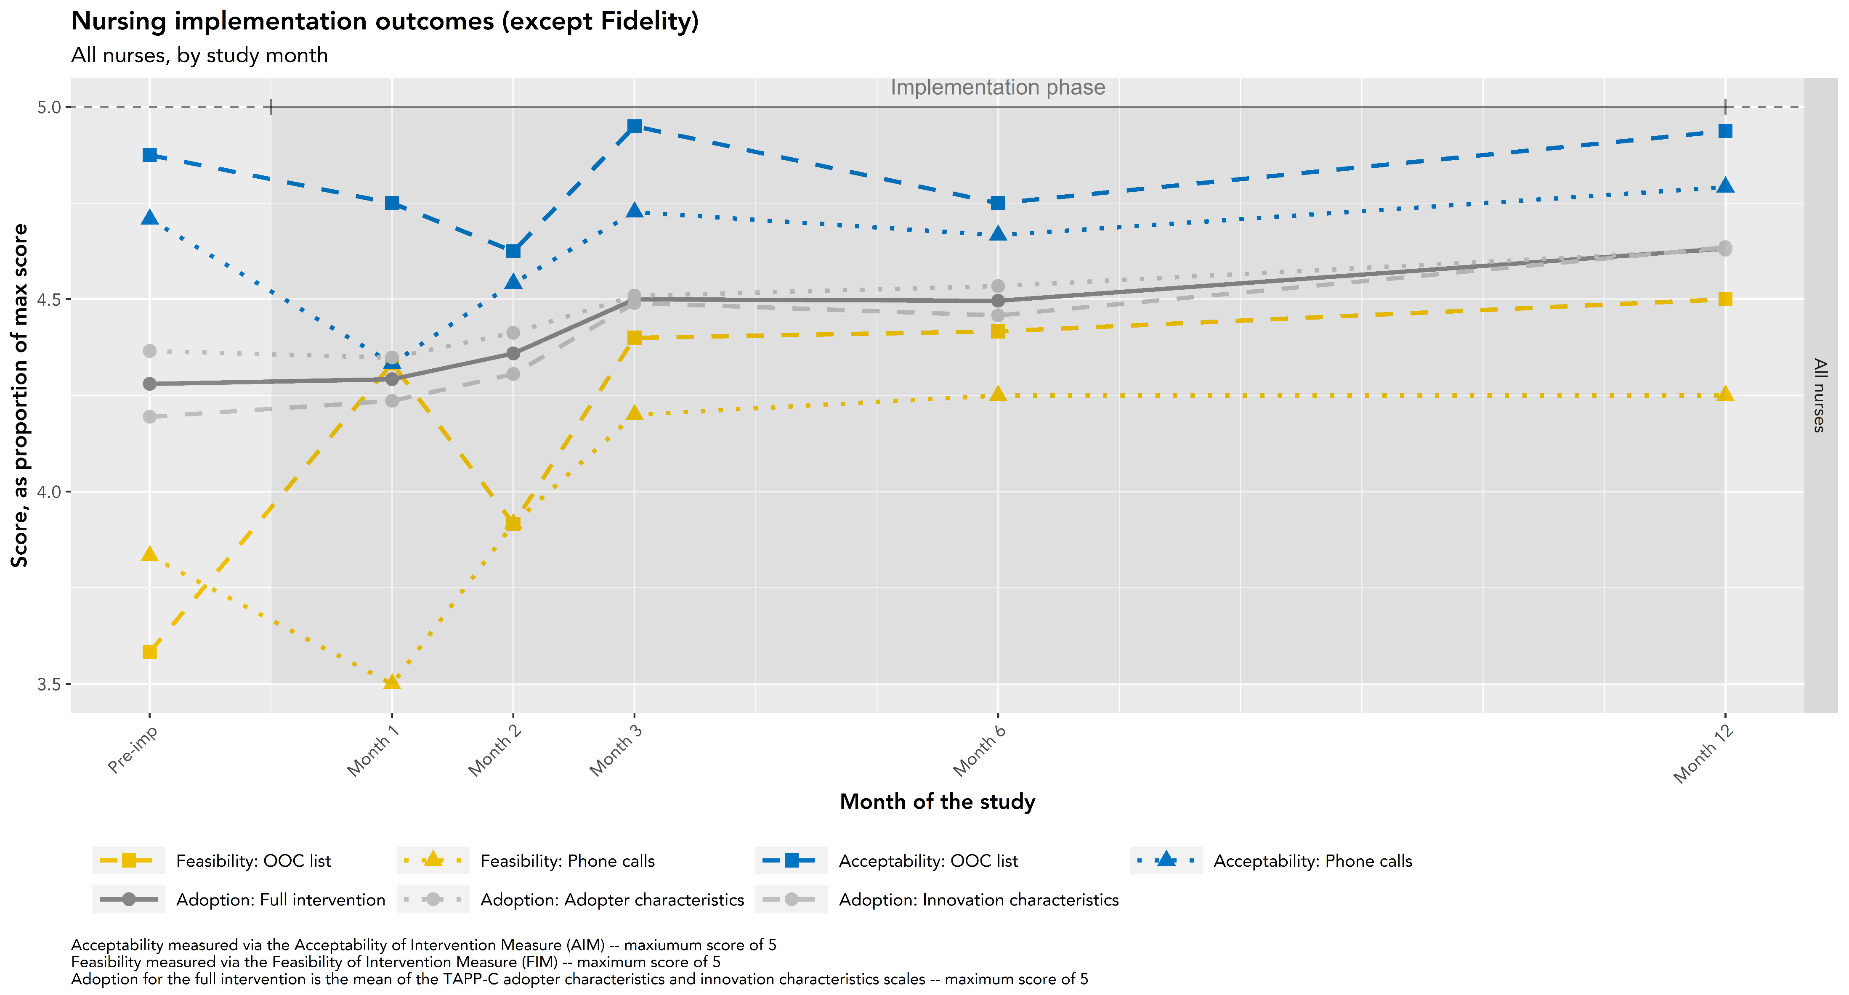
Results

Slide 4
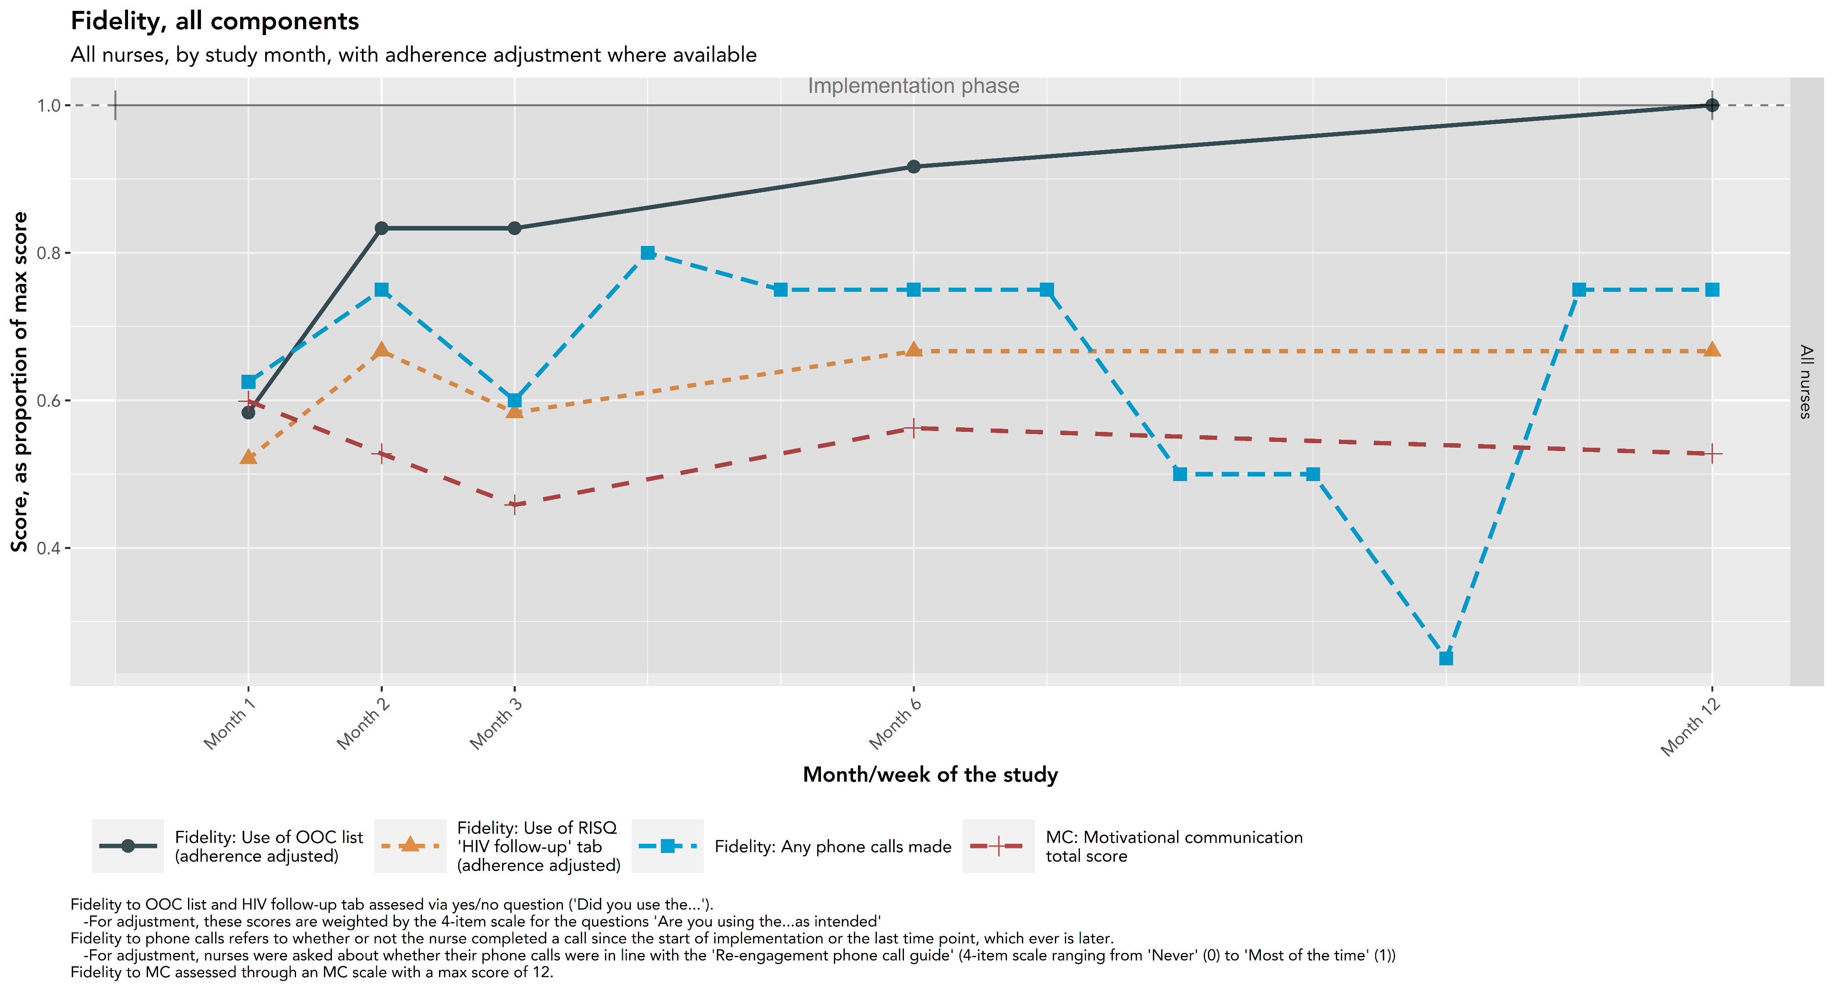
Results

Slide 5
Discussion
Two general patterns in implementation outcomes (other than fidelity):
  High pre-implementation scores, followed by a slight drop in earlier months, followed by a return to high scores in later months
  Lower pre-implementation scores increasing to a plateau
Fidelity stable or increasing over study
  Low rates of “phone calls made” reflective of task shifting
    Nurses assigned one person as primary for Lost & found activities, who made phone calls each month
    Possibly an adjustment to human resource limitations – an important risk factor in Lost & Found implementation
Early months critical to identify and address threats to Lost & Found implementation
  Low scores in earlier months reflective of:
    Technical difficulties, followed by corrections and related adaptations (e.g. improving function of the OOC-RPT)
    Nature of the intervention, requiring clean-up of the OOC-list in earlier months
  Similar trends between fidelity to OOC-list, as well as feasibility and acceptability of phone calls
    Feasibility the most upstream – may be an important factor for Lost & Found implementation.
Results limited by low sample size
  N = 4 for most months

